Slide 1
Nextef results ＆ status
International Workshop on Breakdown Science and High Gradient Technology
KEK, Japan
18 April 2012
Toshi Higo

Slide 2
Contents
Status of Japan and KEK under recovery
Normal conducting X-band studies at KEK
Comparison of four CLIC prototype structures
Undamped prototype T24 result
Damped prototype TD24 result (in operation)
CLIC pulse operation
Effort to identify trigger source leading to suppress breakdowns

Slide 3
Status of Japan under recovery
One year has passed since 11 March, 2011
  Still frequent earthquakes, but frequency decreasing
East Japan under recovery
  From Tsunami disaster
    Establish to be safe against Tsunami
  Reforming the north-east area
    Assignment as a special area for science
Japan under recovery and reform
  Fukushima nuclear plants
    National trend toward reducing nuclear plants
    Government approval of restarting operation

Slide 4
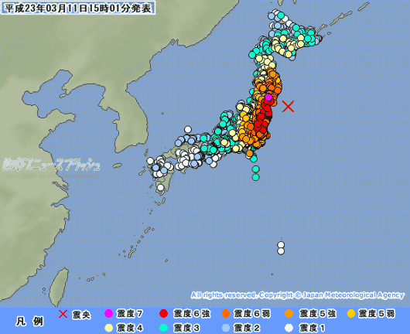
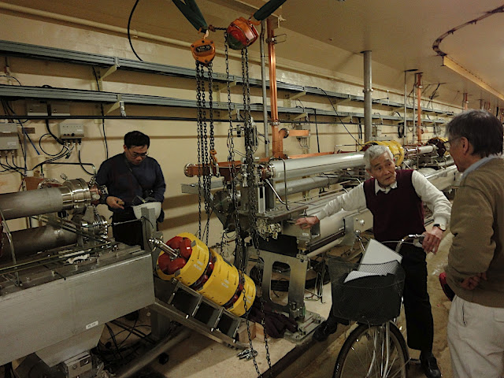
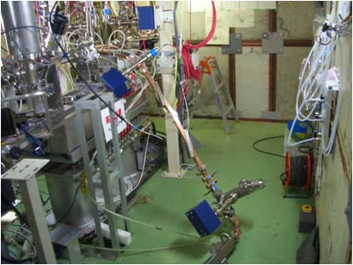
Seismic intensity = 6- at Tsukuba on 11 March, 2011
KEK Injector linac at junction between hard and soft
Nextef collapse
due to non-fixed load

Slide 5
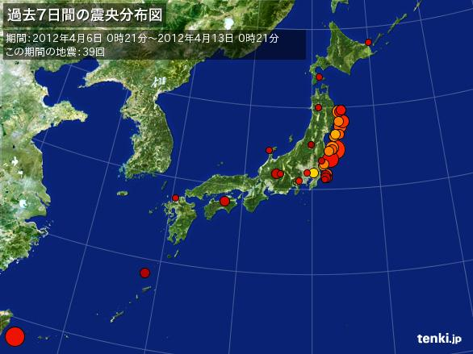

Recent earthquakes in Japan in a week (April 6—13)
We still suffer from frequent earthquakes with seismic intensity of 2~3.
One of the candidate site of ILC in Japan is located in north-east Japan, no big one in several hundred years.

Slide 6
Status of KEK under recovery
One year has passed since 11 March
KEK facilities were quickly recovered
  J-PARC
  Injector linac
  ATF, STF, Nextef, ……
KEK Tsukuba site strategy
  Recovery budget was approved
  Recovery with reinforcement against earthquakes
  Injector linac is being recovered with various improvement, naturally be suited for SuperKEKB

Slide 7
Normal conducting X-band studies at KEK
X-band as a main project of KEK until ITRP 2004
  60cm accelerator structure to confirm operation at 65 MV/m unloaded
Continue high gradient as a basic research for accelerator
Join CLIC collaboration
  22cm accelerator structure targeting the operation at 100 MV/m unloaded
Continue and go into a stage
  To identify the trigger of breakdowns and understand initial processing, operation period, later aging, …..
  Studies to improve initial conditioning and nominal performance and to suppress deterioration through operation
The present workshop is one of the step to this end

Slide 8
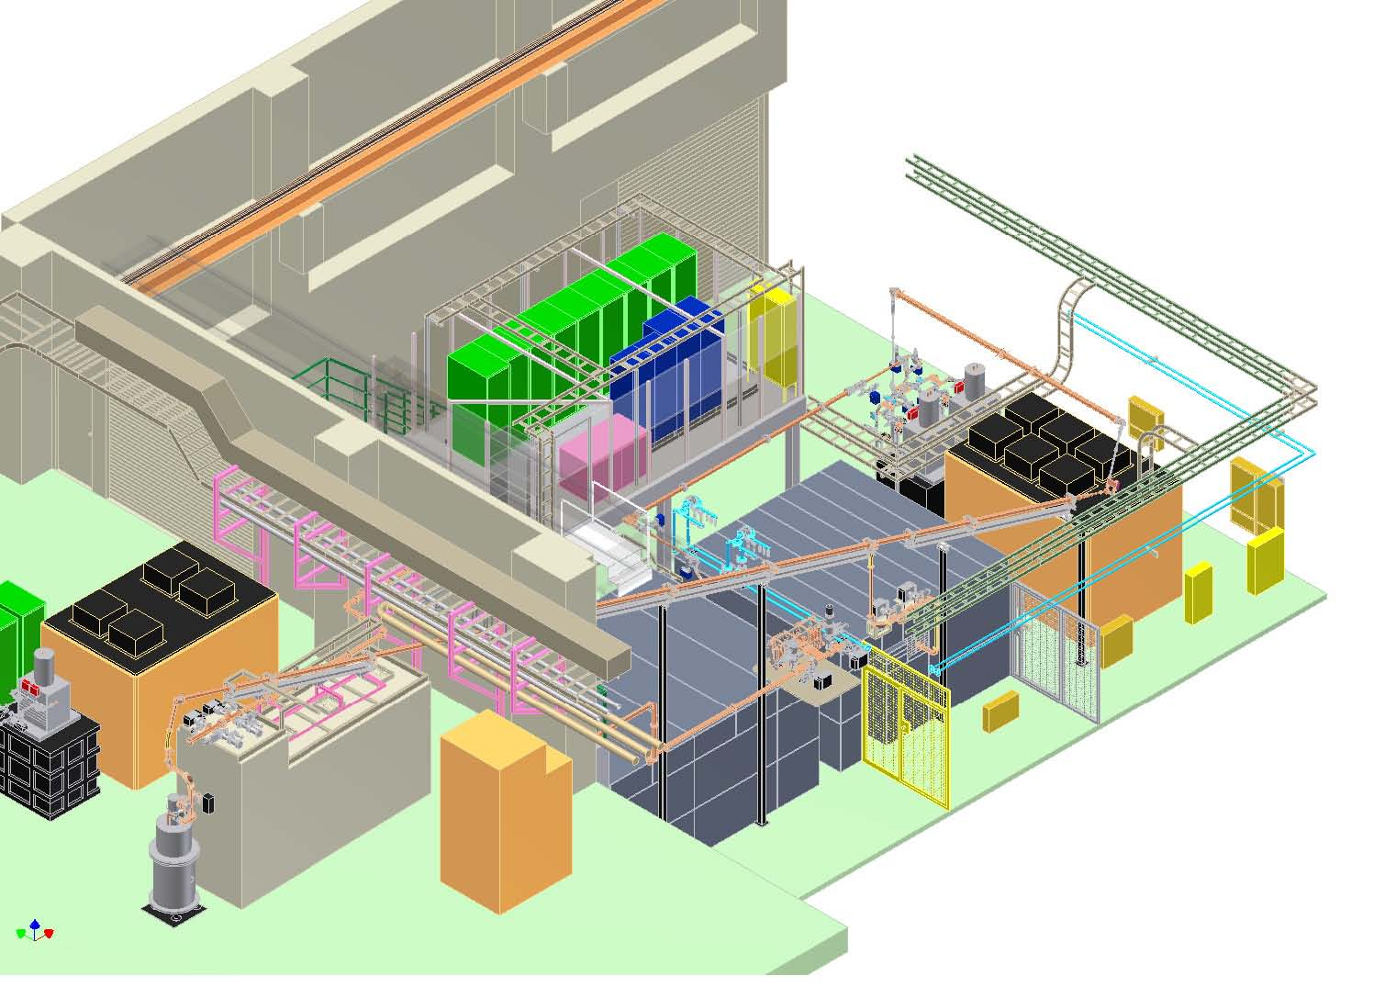
Nextef facilities
Nextef
X-band
KT-1
X-band
B
A
KT-2
C-band

Slide 9
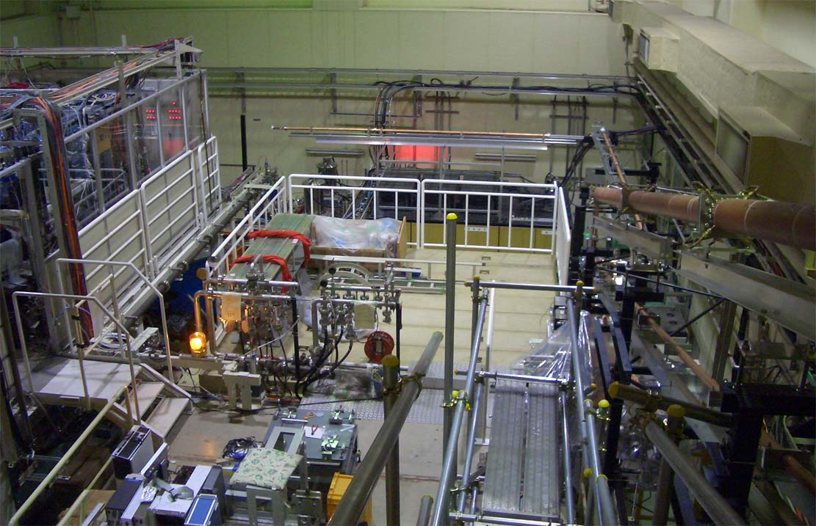
Nextef
RF source
Control
B
A
Power transfer

Slide 10
Comparison of four CLIC prototype structures

Slide 11
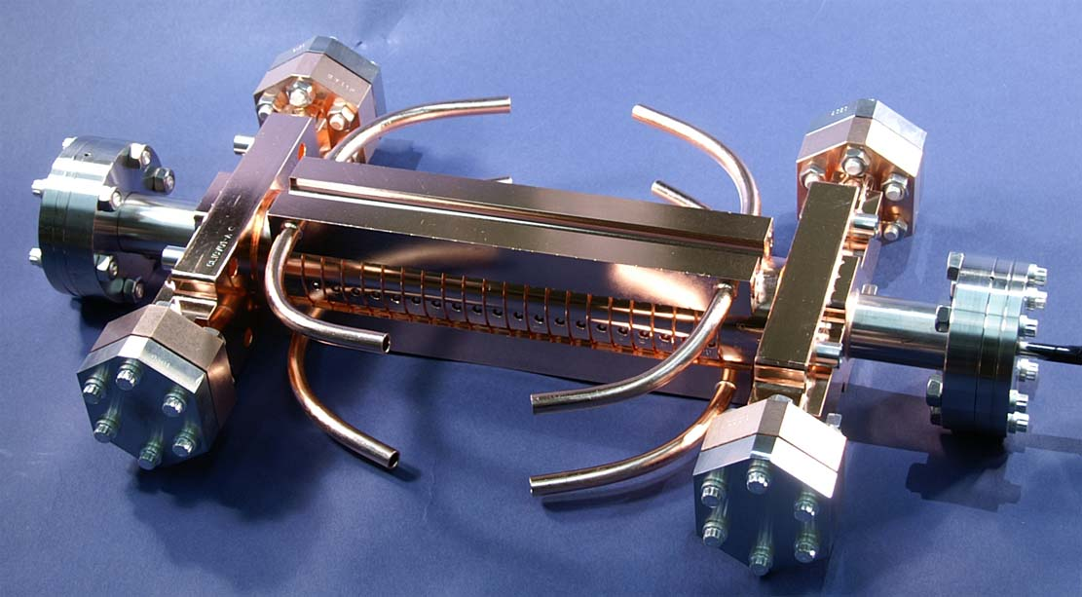
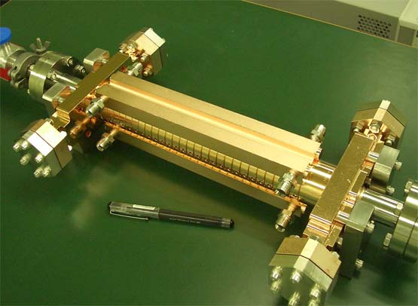


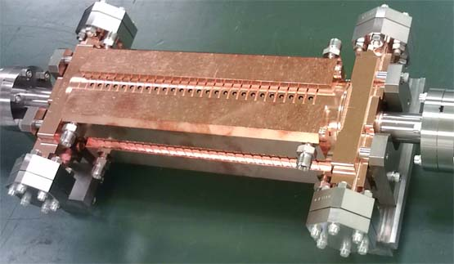
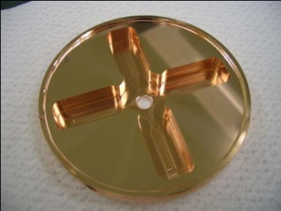
CLIC test structures; a series of fabrication and test
T18 →TD18→T24→TD24
undamped
T24_Disk_#3
T18_Disk_#2
2009
2011
2010
d
2011~12
d
damped
TD18_Disk_#2
TD24_Disk_#4

Slide 12
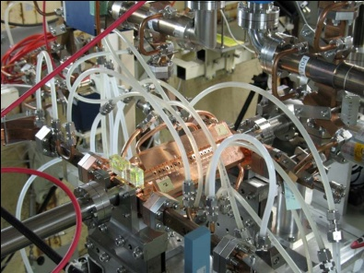
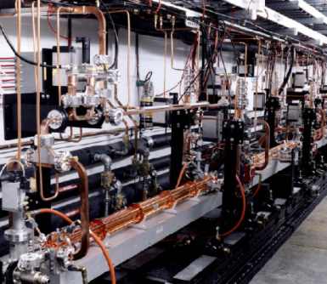

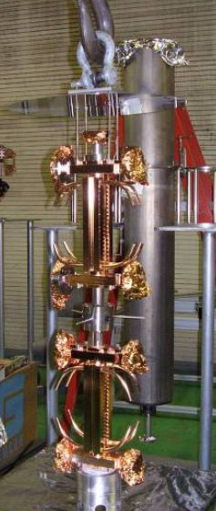
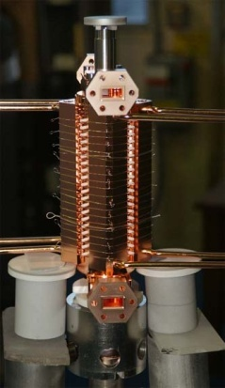
SLAC/KEK typical fab/test flow
Design for CLIC (CERN)
High power test (NLCTA-SLAC)
High power test (Nextef-KEK)
Fabrication of parts (KEK)
CP (SLAC)
VAC bake (SLAC)
Bonding (SLAC)
Notes:
プロトタイプの試験サイクル
ここでも 日米を基礎におく SLAC・KEK キープレーヤー

Slide 13
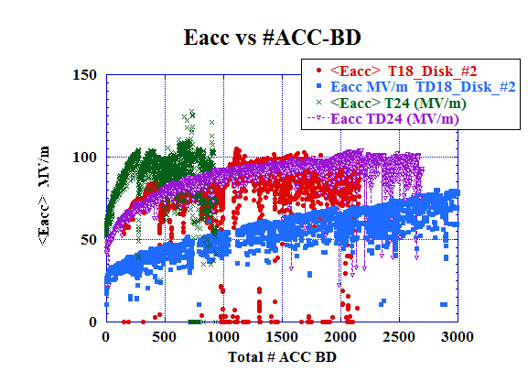
Difference in processing speed among four structures
More BD’s are required for damped!?
Why?
Can it be reduced?
BD’s are essentially needed for processing?
T24
T18
TD24
TD18
Breakdowns are needed or can be avoided?

Slide 14
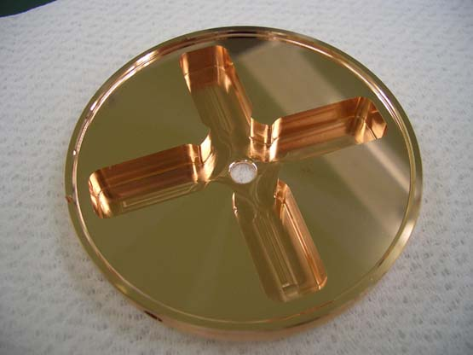
Reduced magnetic field 18 → 24
Alexej Grudiev
TD18
Damped
TD24
Damped
TD18 unloaded
100MV/m
TD24 unloaded
100MV/m
Sc
Es
P (MW), Es (MV/m), Ea (MV/m), ΔT(C), Sc*50 (MW/mm2)
P (MW), Es (MV/m), Ea (MV/m), ΔT(C), Sc*50 (MW/mm2)
Ea
P
ΔT
Iris number
High Eacc and Es and ΔT
Reduce ΔT
Notes:
TW CLICプロトタイプ 試験 結果
Undamp 100MV/m
Damped → 80MV/m 実現

Slide 15
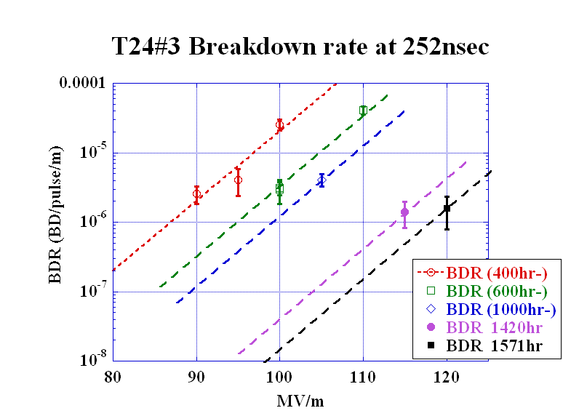
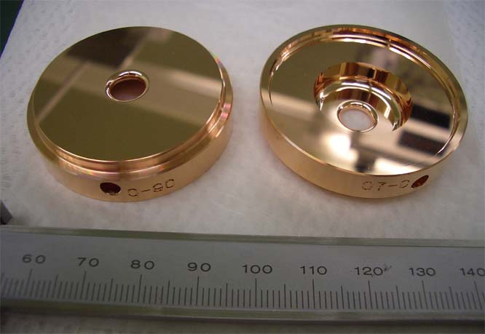
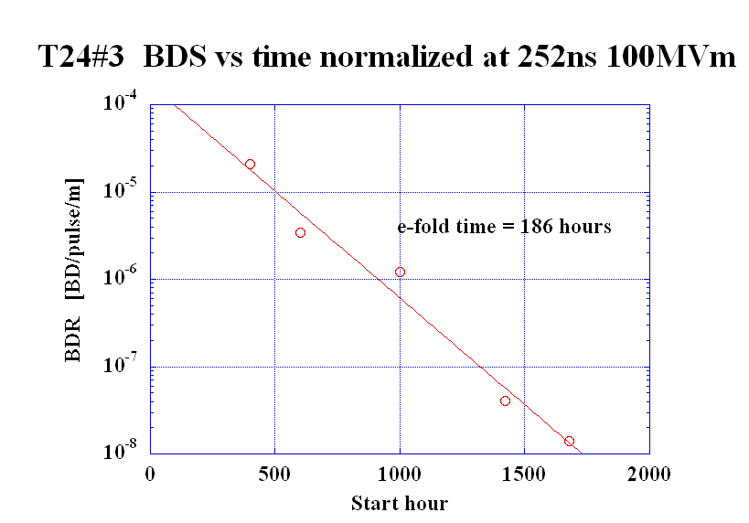
Undamped T24
T24 was found much better than T18
Faster processing
Reached low breakdown rate
3x10⁻⁷

Slide 16
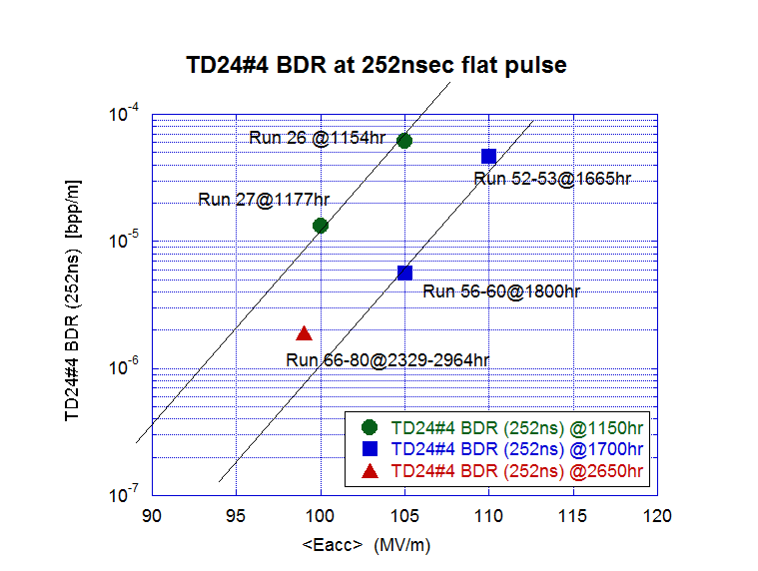
Damped TD24#4 at 252ns

Slide 17
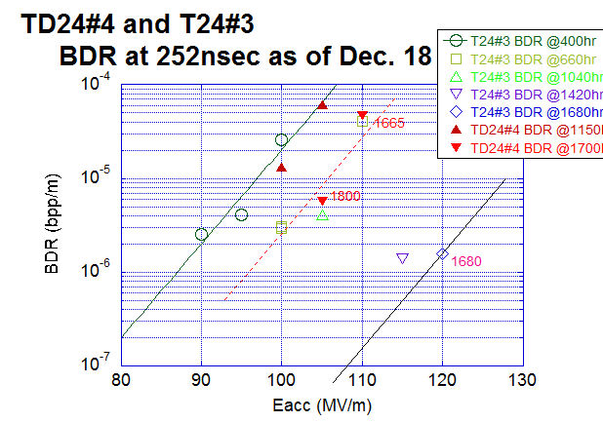
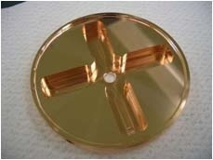
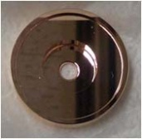
Damped vs undamped
Lines are only for guide for eye and drawn all with the same slope as that of T24 at 40 hr.

Slide 18
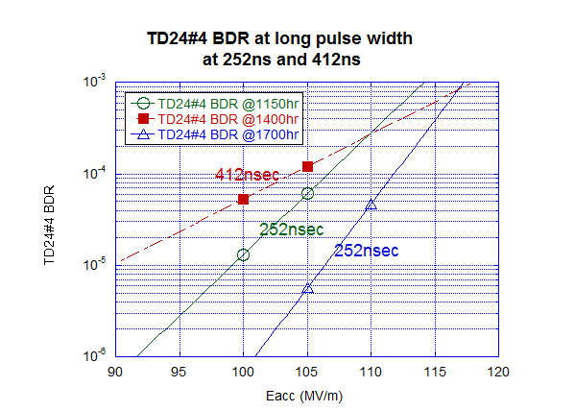
More frequent breakdowns in longer pulse
Not easy to say only from this figure, but longer pulse makes more frequent breakdowns.
Investigate CLIC pulse: effectively shorter pulse.

Slide 19
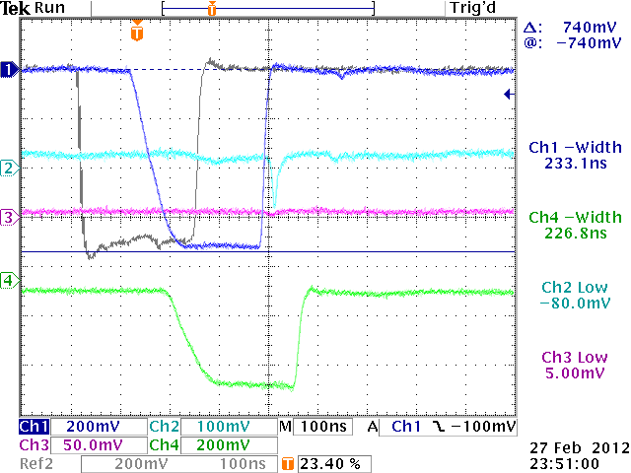
Nominal CLIC pulse
F(CLIC)
Rs
Tr

Slide 20
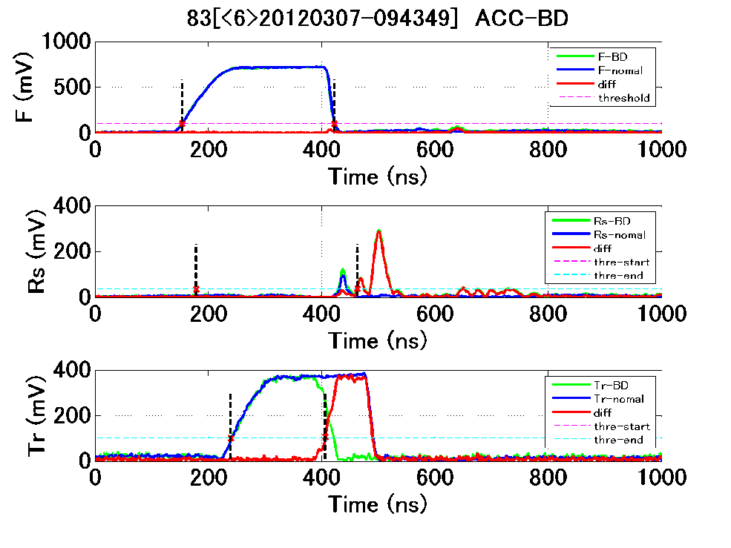
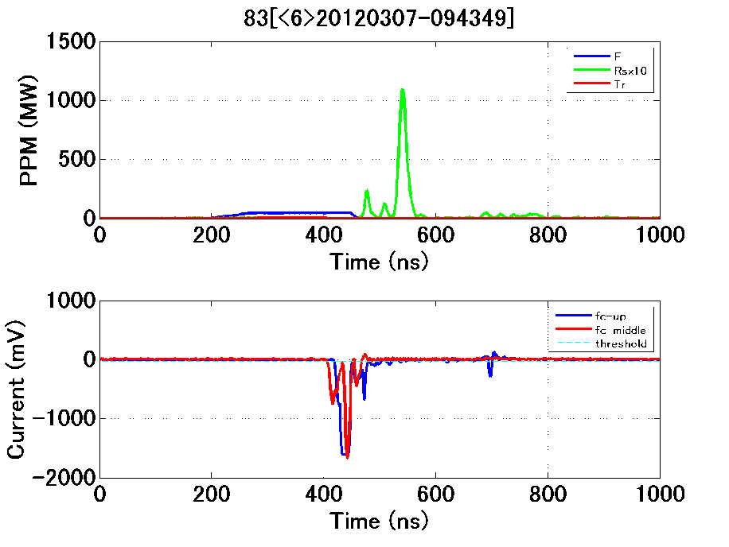
Only 3 breakdowns in 484 hour operation with CLIC pulse at FLT=100MV/m
1.6x10⁻⁷ bpp/m
ACC-IN
Rs
Tr
Rs
F
FC-UP
FC-Mid

Slide 21
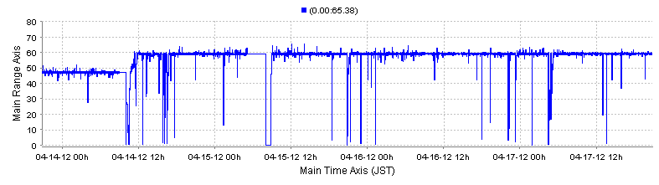
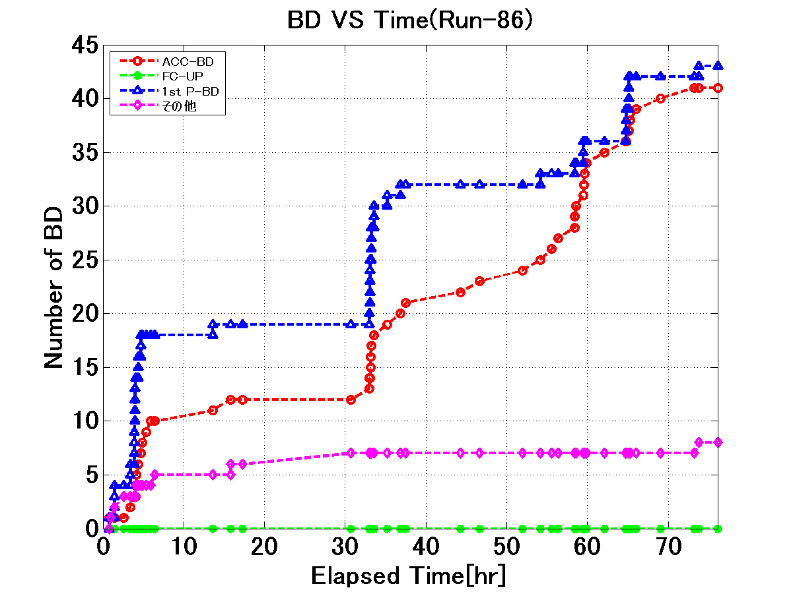
CLIC pulse at 110 MV/m till to date
ACC-IN power
Operated for 77 hours and encountered 41 ACC-BD.
It results in 1.4X10⁻⁵ bpp/m.
BD’s are bunched in time.
BD’s are mostly associated with first-pulse BD’s.
1st pulse-BD
ACC-BD

Slide 22
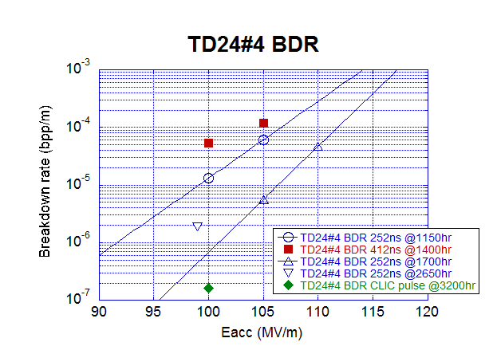
TD24#4 BDR with CLIC pulse
at FLT=100MV/m

Slide 23
Single-cell studies in preparation or in mind
Explore basic research in a simple geometry
Center cell is such as the following
  Standard: KEK made – SLAC test
  Nominal: Heavily-damped
  Made of large-grain material
  Undamped but all-milled
  All milled quadrant type
  Choke-mode type
These are under preparation
Notes:
継続申請の3年間の目標 概略
基礎試験の立ち上げ
複合材料を含めた試験
TWでの可能性 見極め
放電頻度を決める放電のトリガーの理解
100MV/m超の加速ユニットの提案

Slide 24
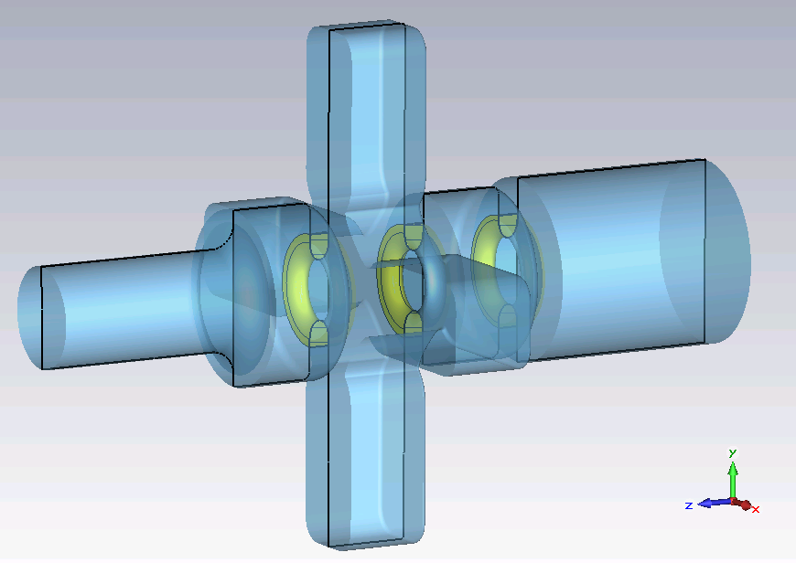
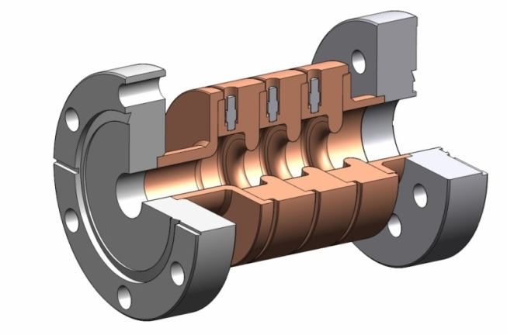
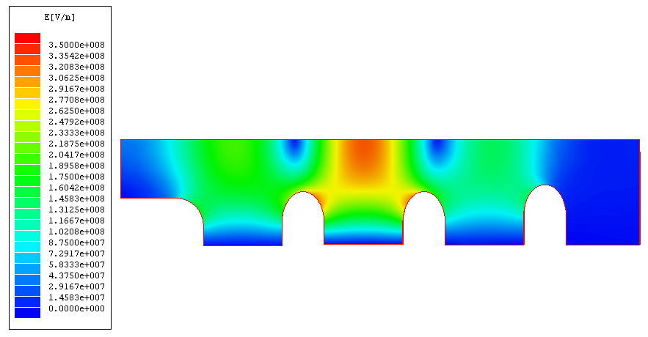
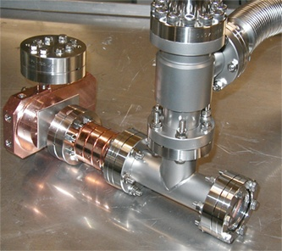
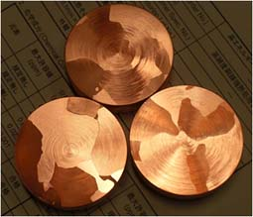
Basic study setups
Damped cell
High field only at center cell
Crystal characteristics
Clean setup

Slide 25
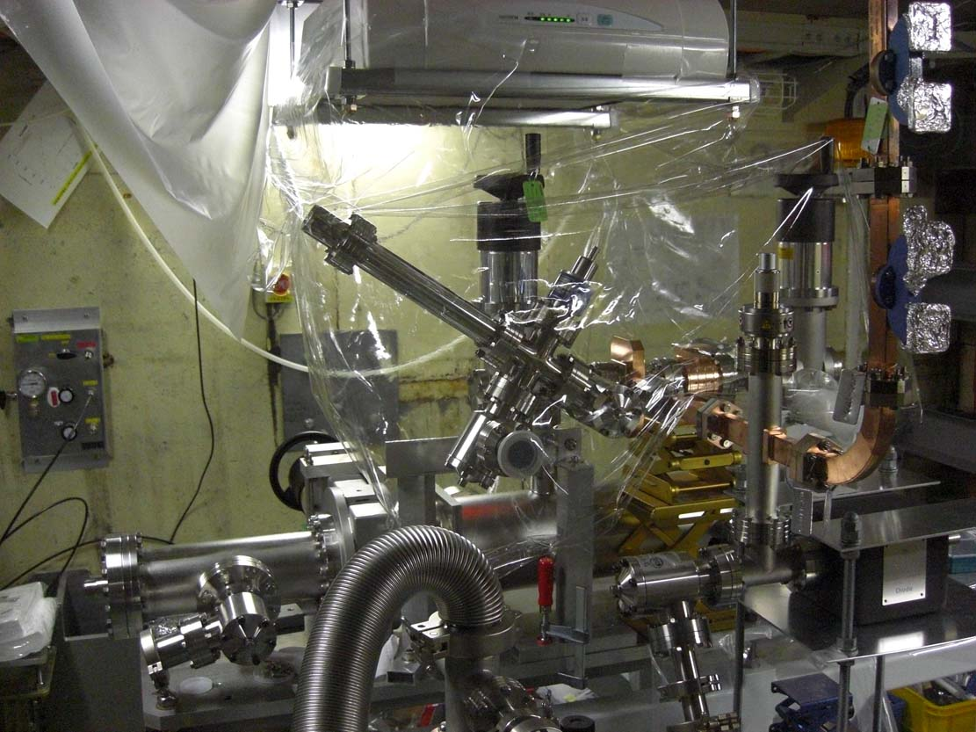
Preparation of setup in shield-B
HEPA
GV
Cavity
NEG
Waveguide

Slide 26
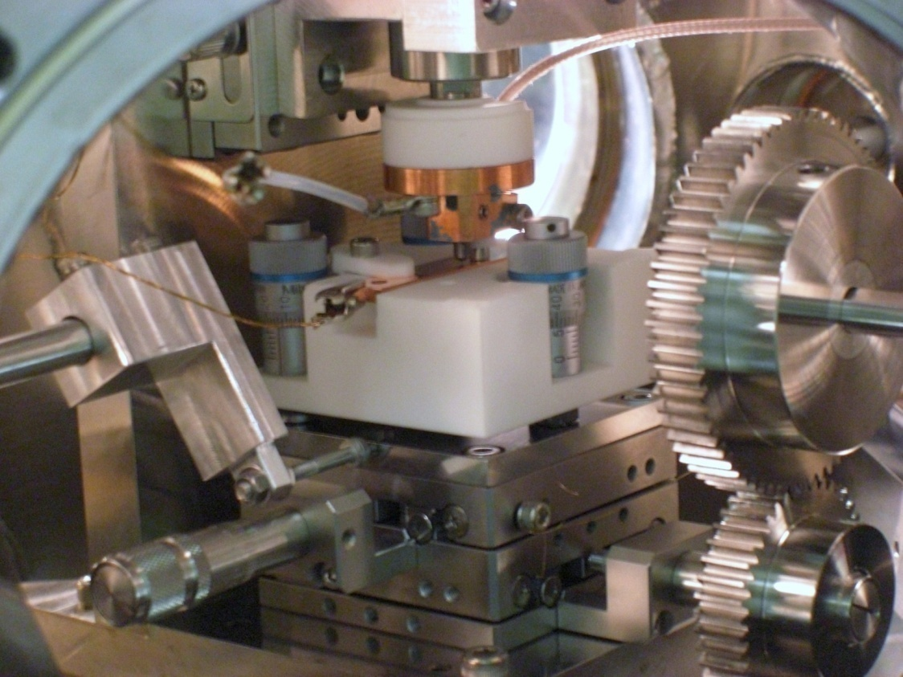
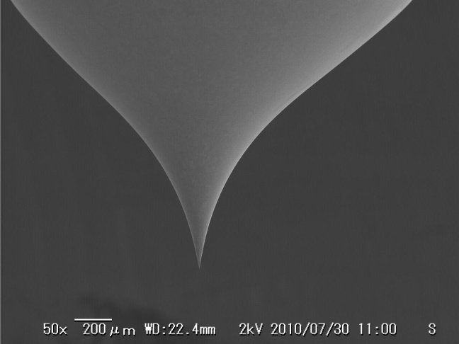
Scanning field emission microscope being under development at KEK
PIEZO actuator
Capacitance gauge
W-Tip
Sample
W-Tip
XY stage
Field emission and surface of crystal characteristics.

Slide 27
Conclusion
Four CLIC prototype structures have been tested, each for a few thousand hour scale.
Improved performance was given with TD24 type.
CLIC pulse operation met the required BDR for CLIC at FLT=100MV/m.
Basic research area is under construction, expecting to start test in a month or so.
All of KEK members suffer from the huge work for SuperKEKB until the commissioning in 2014.
We want to keep the basic research activity.
We also want to consider a klystron based compact LC for Higgs.
We want to expand X-band based applications, but after SuperKEKB.

